Slide 1
Image Filtering

Slide 2
Image filtering
As for one-dimensional signals, images also can be filtered with various low-pass filters (LPF), high-pass filters (HPF), etc.
A LPF helps in removing noise, or blurring the image.
A HPF filters helps in finding edges in an image and sharpen the image.
Fourier Transform is used to make these filter by signal processing.
High frequency image is one where the intensity changes a lot.
Low frequency image is one where the intensity remains constant.

Slide 3
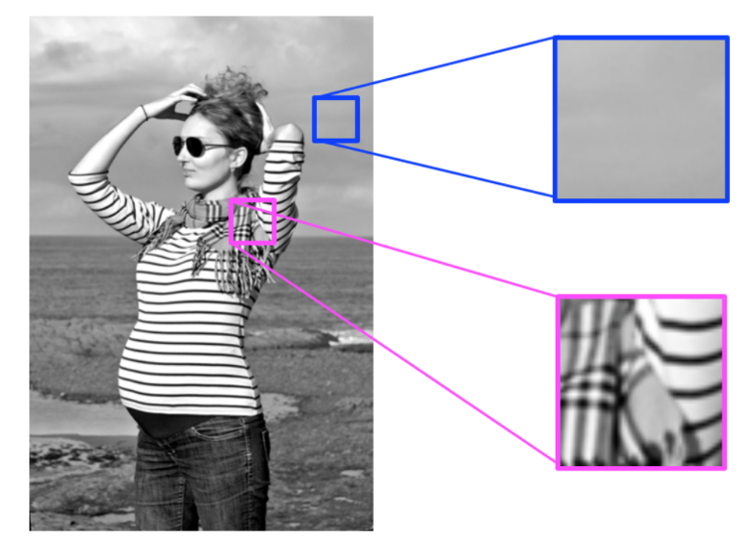
High and low frequency

Slide 4
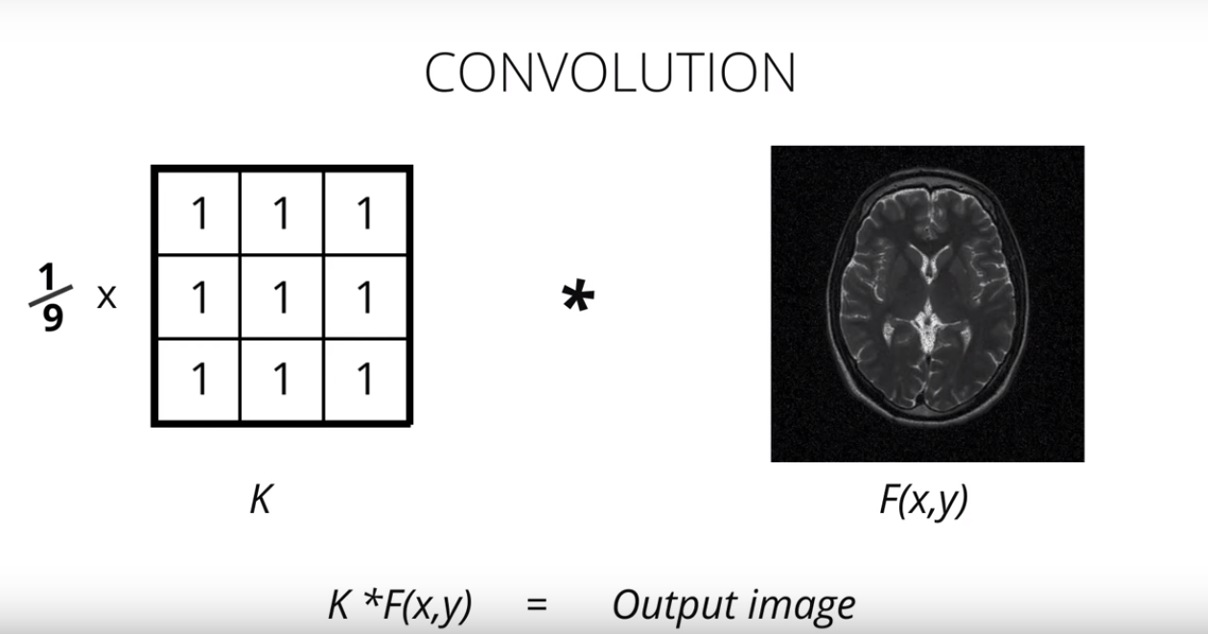
Convolution

Slide 5
2D Convolution
OpenCV provides a function, cv2.filter2D(), to convolve a kernel with an image. As an example, we will try an averaging filter on an image.
Filtering with the above kernel results in the following being performed: for each pixel, a 5x5 window is centered on this pixel, all pixels falling within this window are summed up, and the result is then divided by 25.
This equates to computing the average of the pixel values inside that window. This operation is performed for all the pixels in the image to produce the output filtered image.

Slide 6
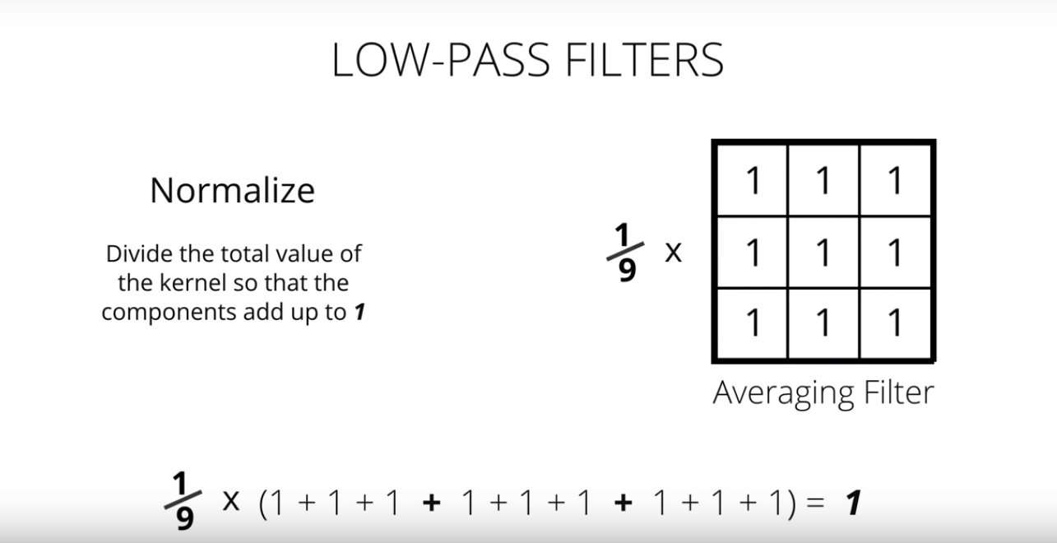
Low pass filter

Slide 7
Image Blurring (Image Smoothing)
Image blurring is achieved by convolving the image with a low-pass filter kernel.
It actually removes high frequency content (e.g: noise, edges) from the image resulting in edges being blurred when this is filter is applied.
1. Averaging
2. Gaussian Filtering
3. Median Filtering
4. Bilateral Filtering

Slide 8
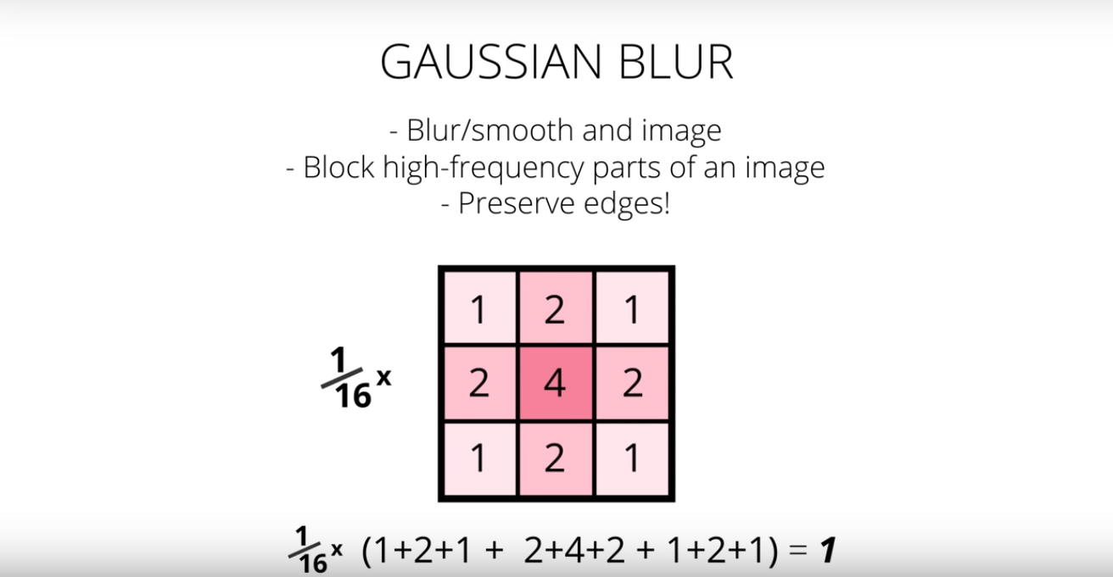
Gaussian Blur

Slide 9
Canny Edge Detection
Noise Reduction
Finding Intensity Gradient of the Image
Non-maximum Suppression
Hysteresis Thresholding

Slide 10
Canny Edge Detection
import cv2
import numpy as np
from matplotlib import pyplot as plt
img = cv2.imread(‘dog.jpg’,0)
edges = cv2.Canny(img,100,200)
plt.subplot(121),plt.imshow(img,cmap = 'gray')
plt.title('Original Image'), plt.xticks([]), plt.yticks([])
plt.subplot(122),plt.imshow(edges,cmap = 'gray')
plt.title('Edge Image'), plt.xticks([]), plt.yticks([])
plt.show()

